Slide 1


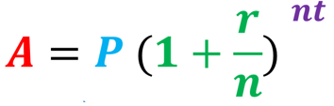

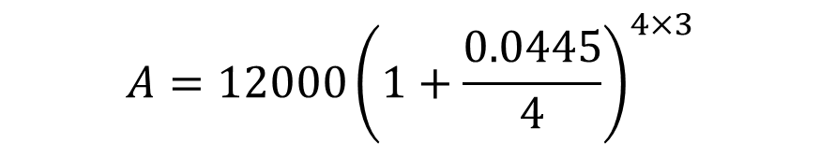







Y11 Apps Chapter 4 Example 7
Clive needs to borrow $12 000 to buy a machine for his factory. He wants to pay back the loan in full in 3 years time. He is offered three different loans. Which one should he pick?
Quick Loans:
Simple interest of 6% p.a.
Zoom Loans:
Compound interest of 4.5% p.a.
Magic Loans:
Compound interest of 4.45% p.a., compounded quarterly
$$I=12000×0.06×3$$
$$A=12000{(1+0.045)}^{3}$$
$$A=12000{\left(1+\frac{0.0445}{4}\right)}^{4×3}$$
$$I=2 160$$
$$A=\$13 693.99$$
$$A=P+I$$
$$A=\$13703.75$$
$$A=12 000+2 160$$
He should pick Zoom loans as he will have to repay the least amount of money.
$$A=\$14 160$$

Slide 2

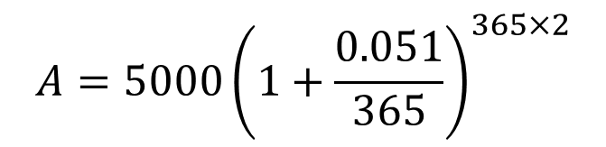

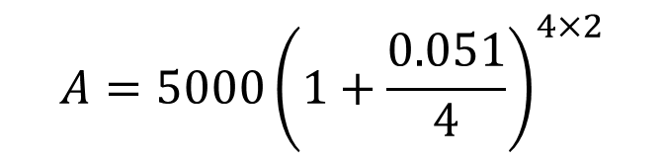
Y11 Apps Chapter 4 Example 8
Martina won $5 000 in the lottery and decides to invest it for 2 years. She is given the choice of an interest rate of 5.1% p.a., compounded quarterly or 5.1% p.a., compounded daily.
Which is the better deal?
First choice:
Second choice:
$$A=5000{\left(1+\frac{0.051}{4}\right)}^{4×2}$$
$$A=5000{\left(1+\frac{0.051}{365}\right)}^{365×2}$$
$$A=\$5 533.35$$
$$A=\$5 536.88$$
The second choice is the better deal as the value of the investment will be greater.

Slide 3
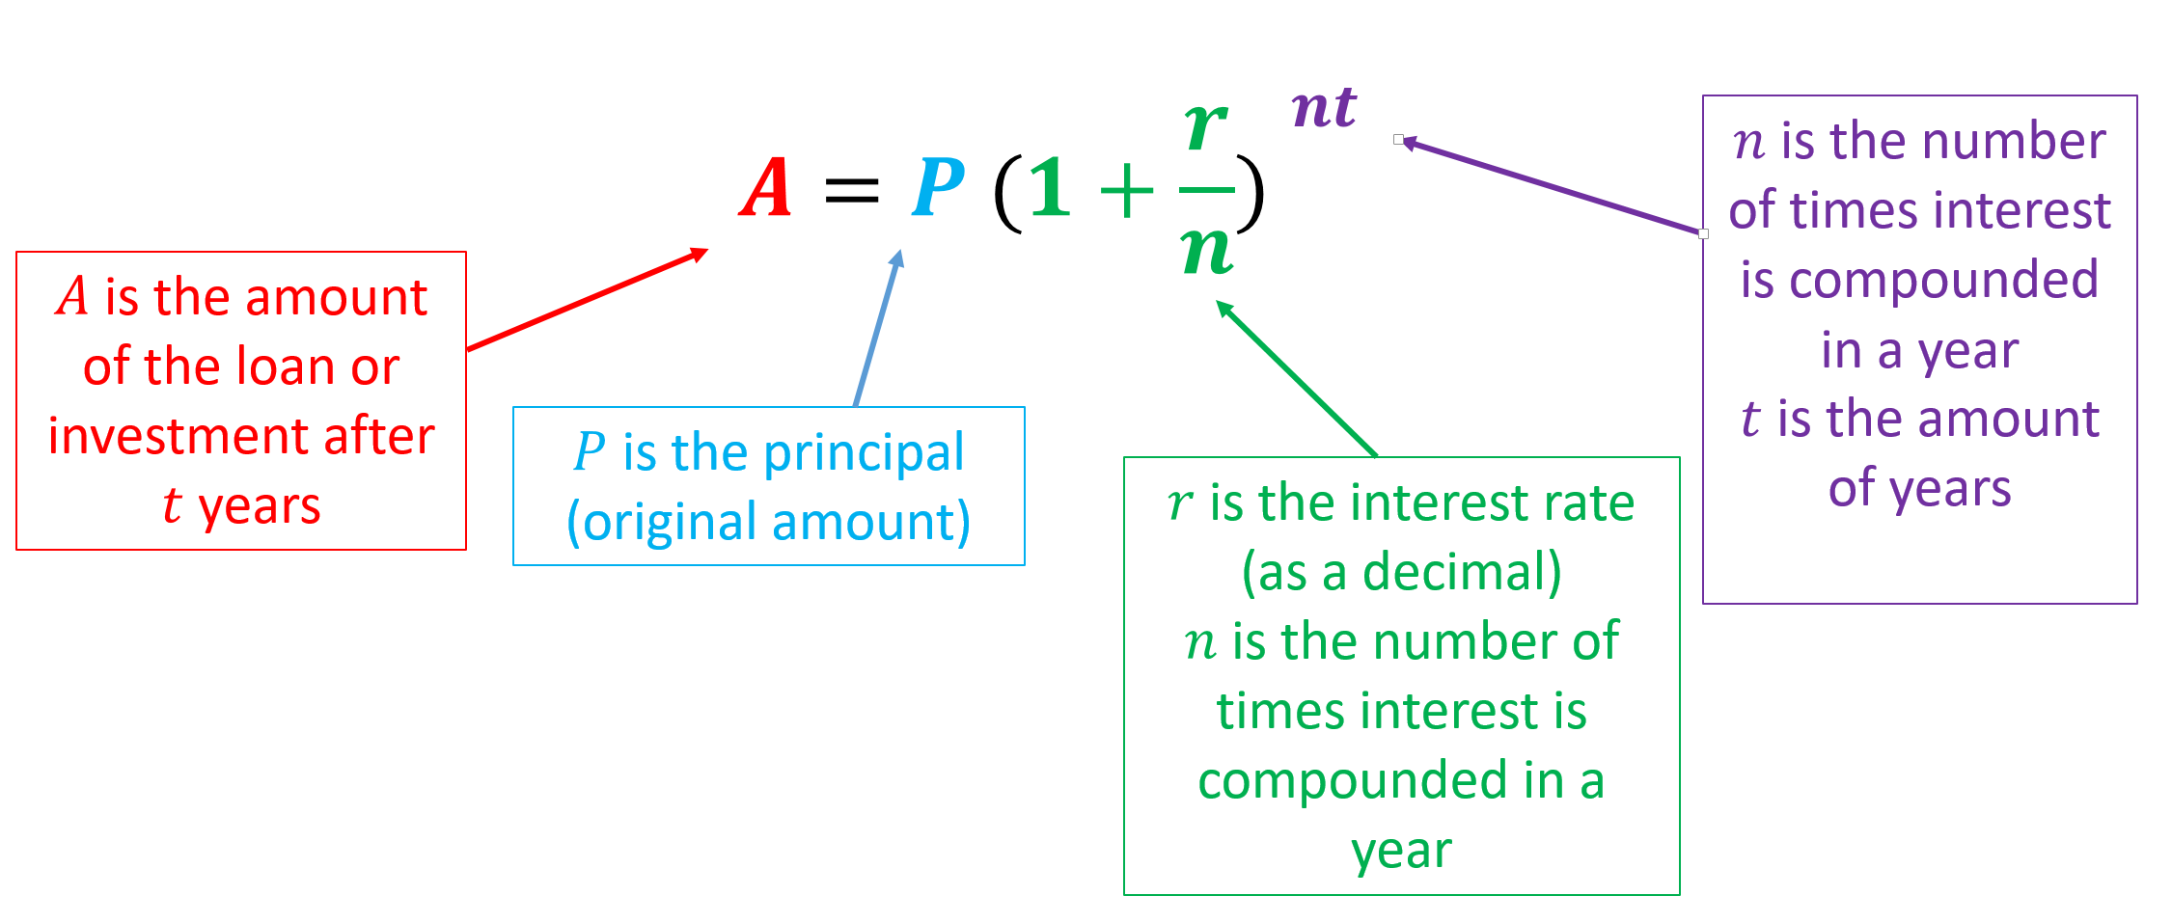
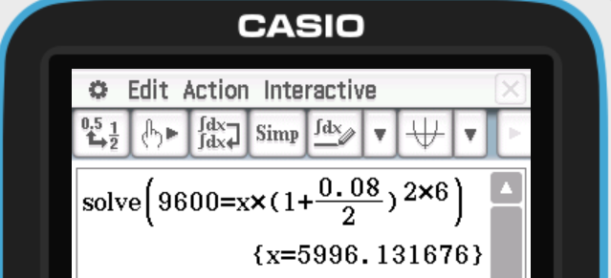

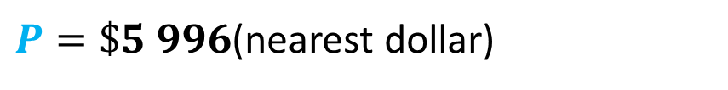





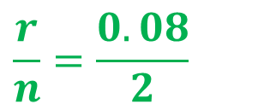
Y11 Apps Chapter 4 Example 9
How much would need to be invested at 8% p.a. compounded each half year to accumulate to $9 600 in 6 years. Round your answer to the nearest dollar.
$$A=9 600$$
$$P=?$$
$$9600=P{\left(1+\frac{0.08}{2}\right)}^{2×6}$$
$$\frac{r}{n}=\frac{0.08}{2}$$
$$9600=P{\left(1.04\right)}^{12}$$
$$nt=2×6$$
$$9600=P(1.601032219)$$
$$\frac{9600}{1.601032219}=P$$
$P=\$5 996$(nearest dollar)

Slide 4
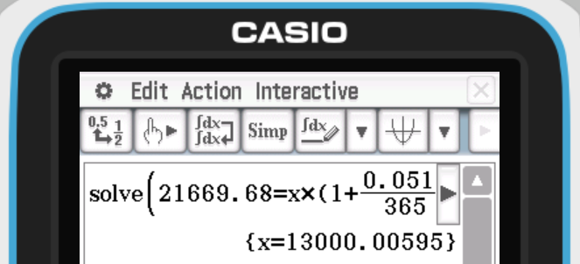

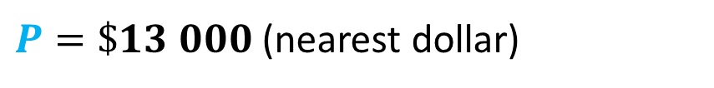



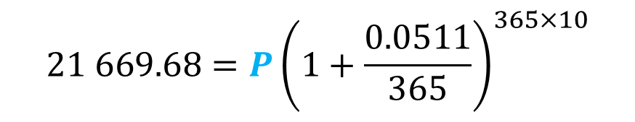

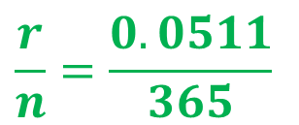
Y11 Apps Chapter 4 Example 10
Aunt Eva leaves Heidi a legacy of some deposit stock that was invested for 10 years at 5.11% p.a. compounded daily. The value of the cheque received was $21 669.68. Calculate the initial deposit. Give your answer to the nearest dollar.
$$21 669.68=P{\left(1+\frac{0.0511}{365}\right)}^{365×10}$$
$$A=21 669.68$$
$$P=?$$
$$21 669.68=P{\left(1.00014\right)}^{3650}$$
$$\frac{r}{n}=\frac{0.0511}{365}$$
$$21 669.68=P(1.6668977)$$
$$\frac{21669.68}{1.6668977}=P$$
$$nt=365×10$$
$P=\$13 000$ (nearest dollar)

Slide 5
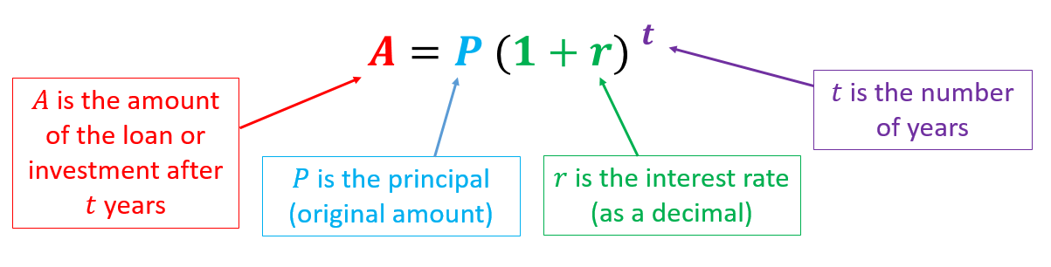
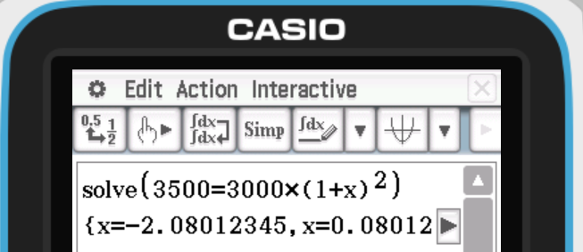



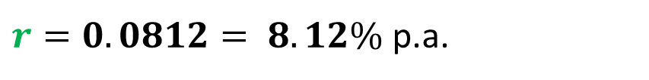



Y11 Apps Chapter 4 Example 11
Sales of $3 000 grow to $3 500 in 2 years. Calculate the percentage growth p.a. rounded to 2 decimal places. Assume the growth compounds annually.
$$A={P (1+r) }^{t}$$
$$A=\$3500$$
$$3500=3000{\left(1+r\right)}^{2}$$
$$P=\$3000$$
$$\frac{3500}{3000}={\left(1+r\right)}^{2}$$
Ignore the negative answer.
$$r=?$$
$$t=2$$
$$1.166666666667={\left(1+r\right)}^{2}$$
$$\sqrt{1.166666666667}=1+r$$
$$1.08012345=1+r$$
$$r=1.0812345−1=0.0812345$$
$r=0.0812= 8.12\%$p.a.

